Slide 1
CS-170 Final Project

Slide 2
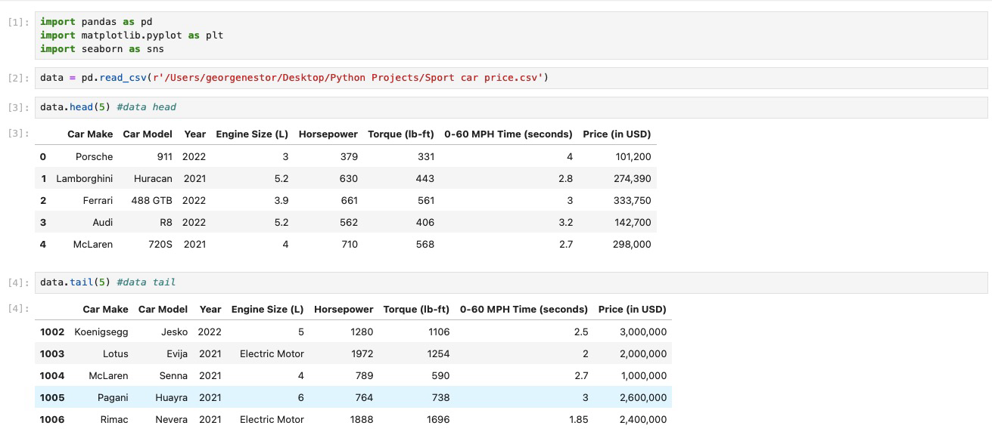
Uploading Data

Slide 3
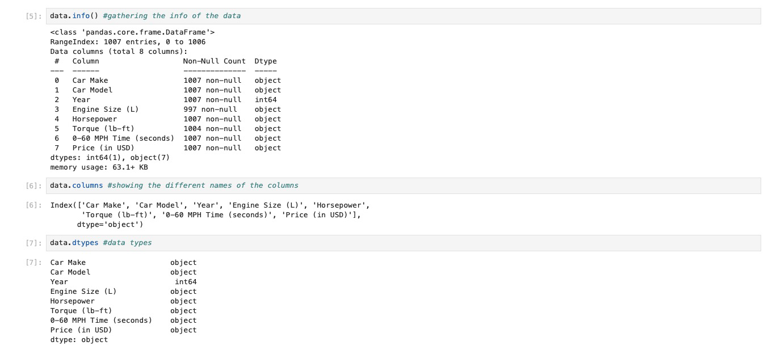
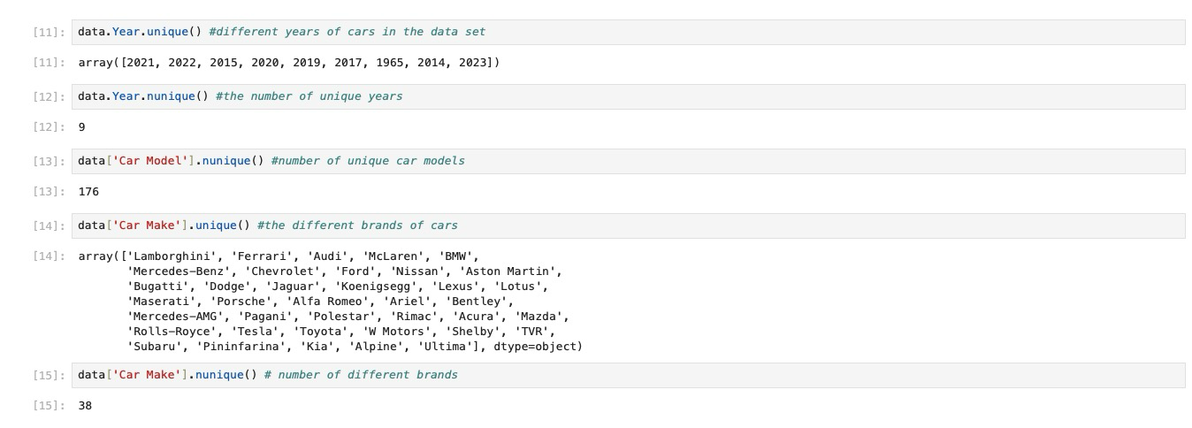
Showing data information

Slide 4
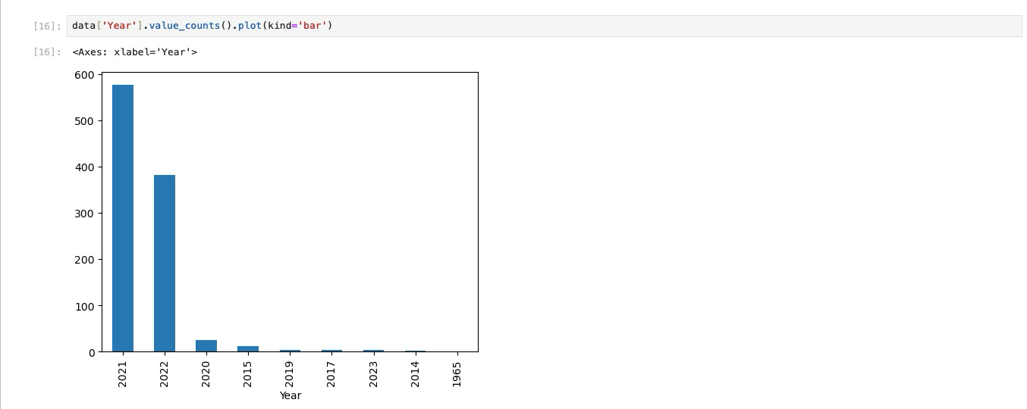
Bar graph of # of cars per year

Slide 5
New Data
Goals
  Find fastest car per year
  Fastest cars per brand
  Best value car, #1 and top 10

Slide 6
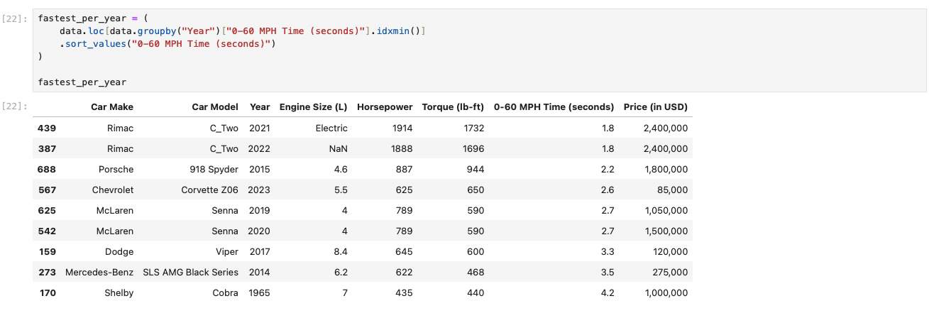
Fastest car per year

Slide 7
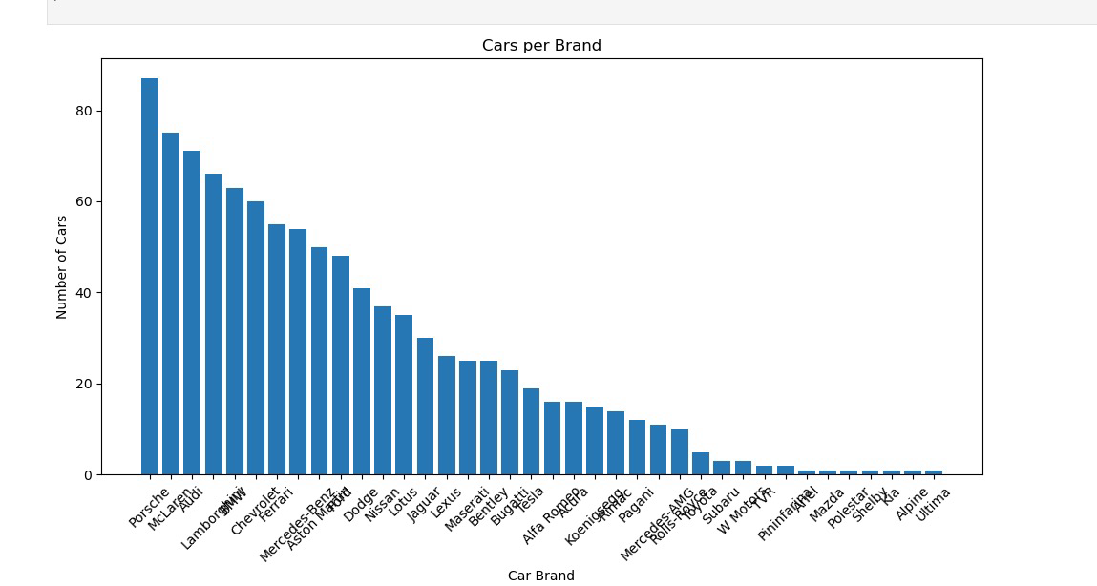
Number of cars per brand

Slide 8
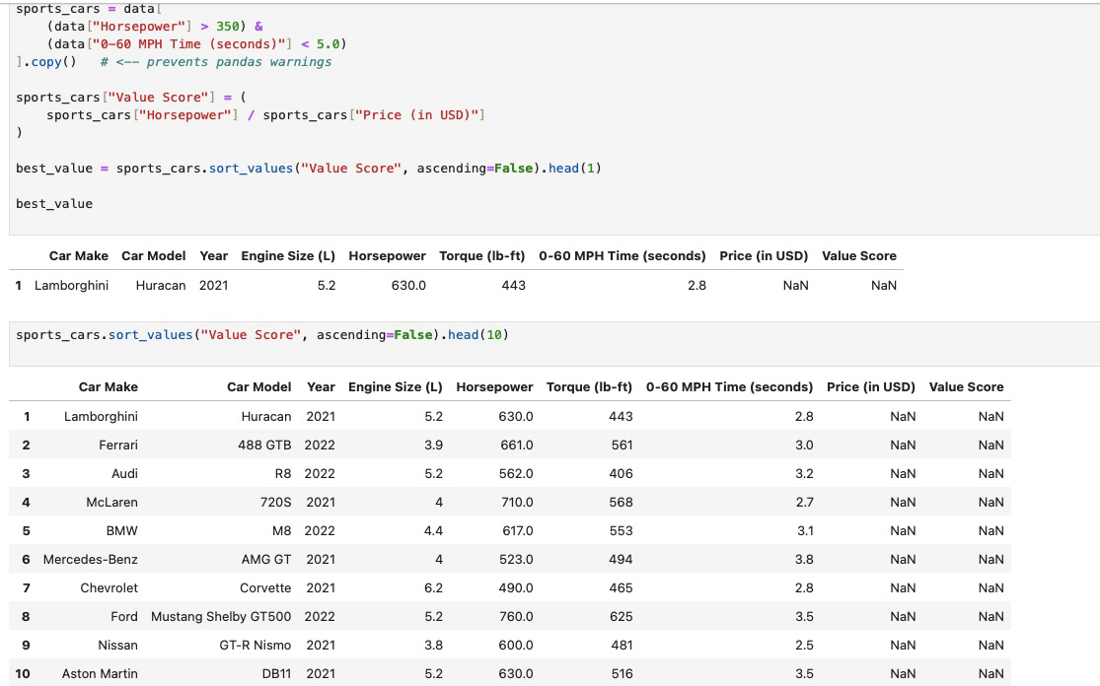
Best value car #1 and top 10

